Slide 1
Secured ख़बरी

Slide 2
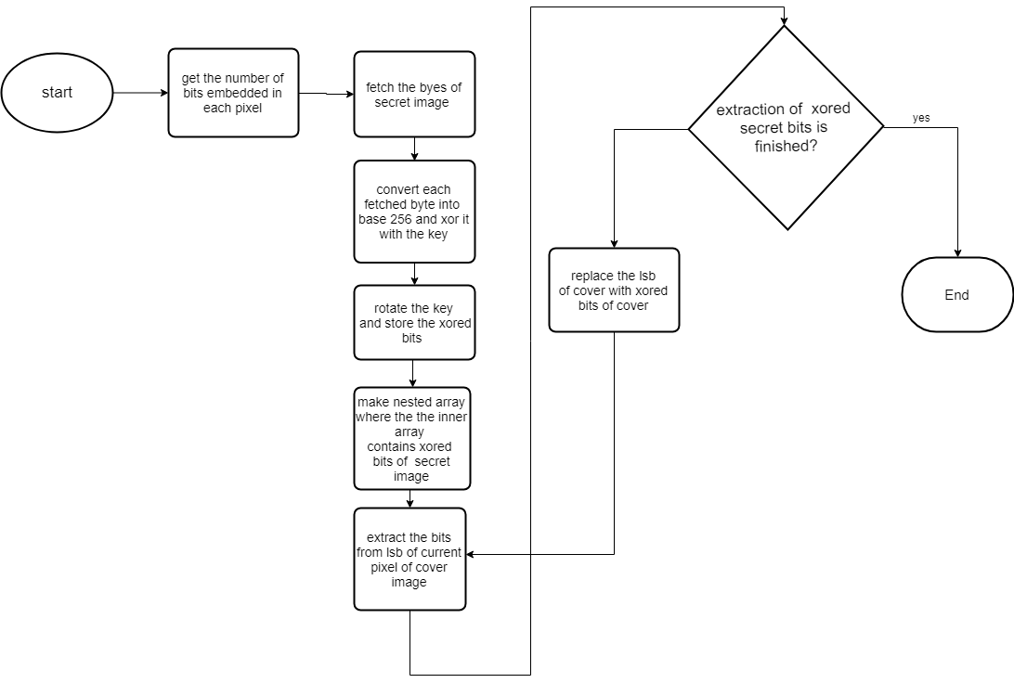
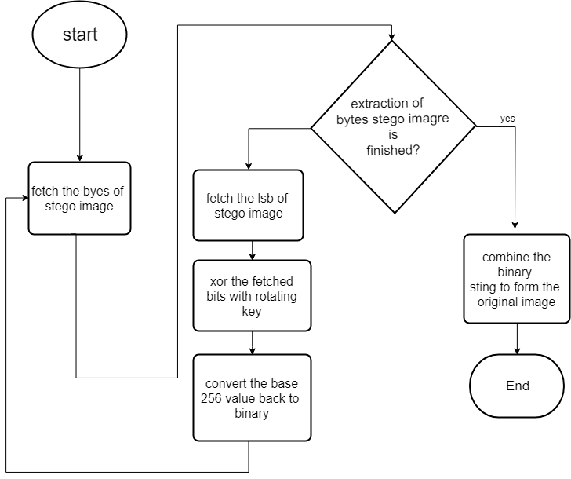
Work done so far
Encoding
decoding

Slide 3
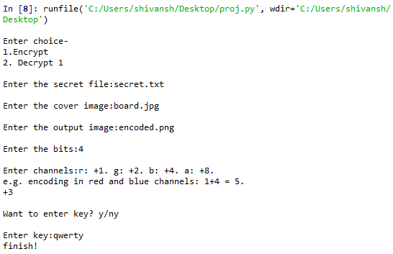
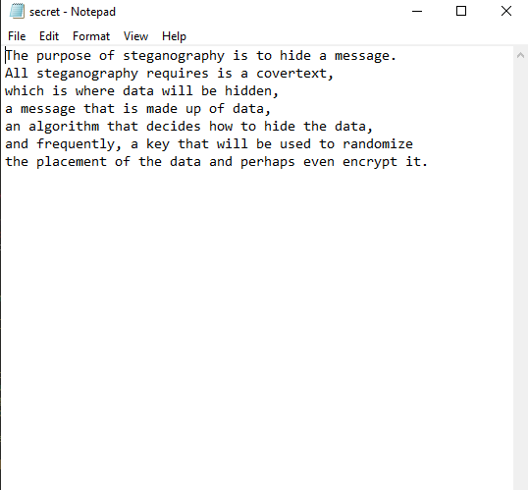
Screenshots
Encryption Menu
Secret message

Slide 4
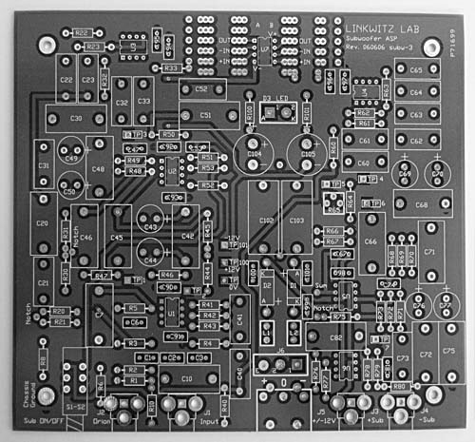
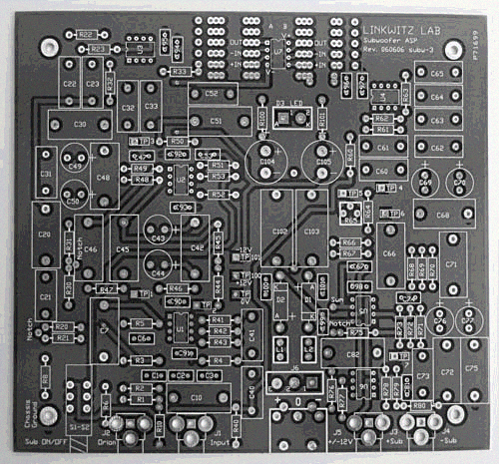
After Encoding
Carrier image
Encoded image

Slide 5
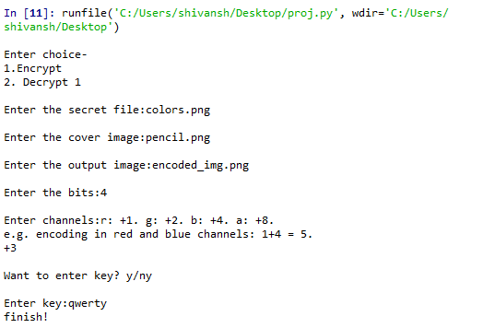

For Images
Encryption Menu
Secret image

Slide 6
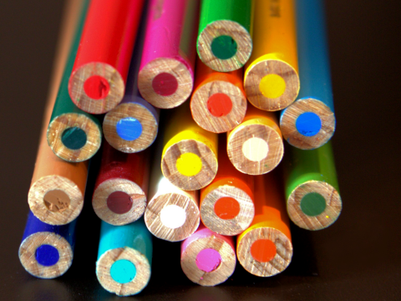
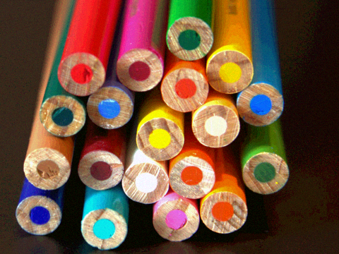
Cover image
Carrier image
Encoded image

Slide 7
Technologies used in Chat App
Flask
MongoDB
Flask-SocketIO
Linux Server
CSS
AJAX
JavaScript
Jinja

Slide 8
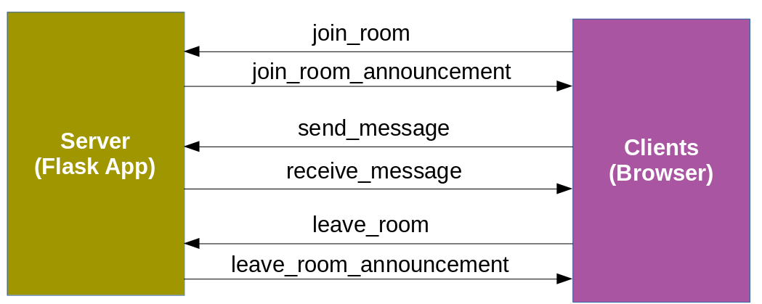
Implementing app
Flow of Events:

Slide 9
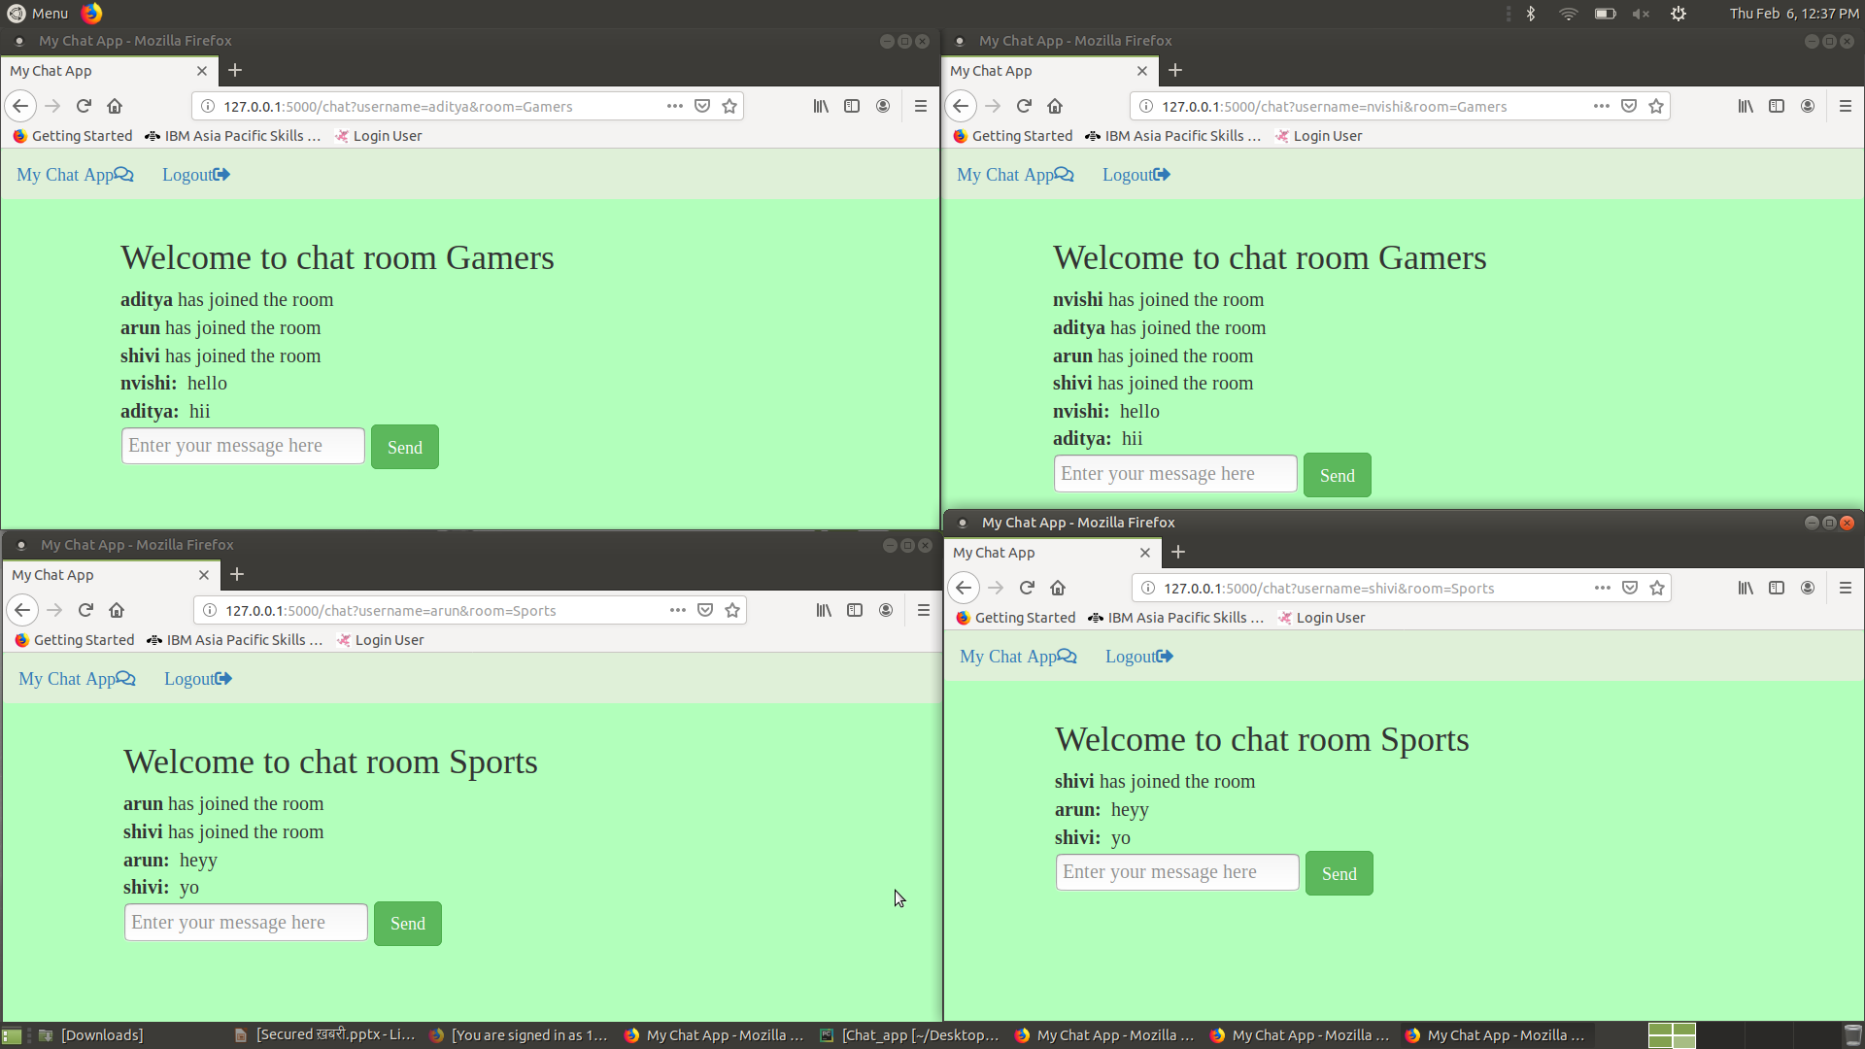
Implementing App

Slide 10
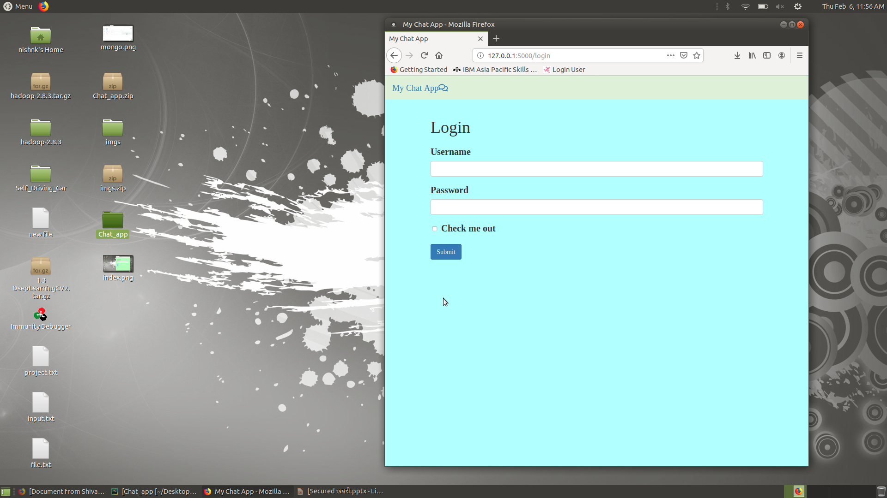
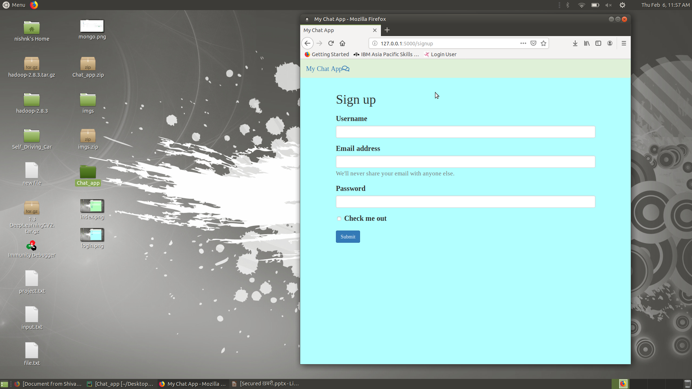
Login and Signup to Our Chat App

Slide 11
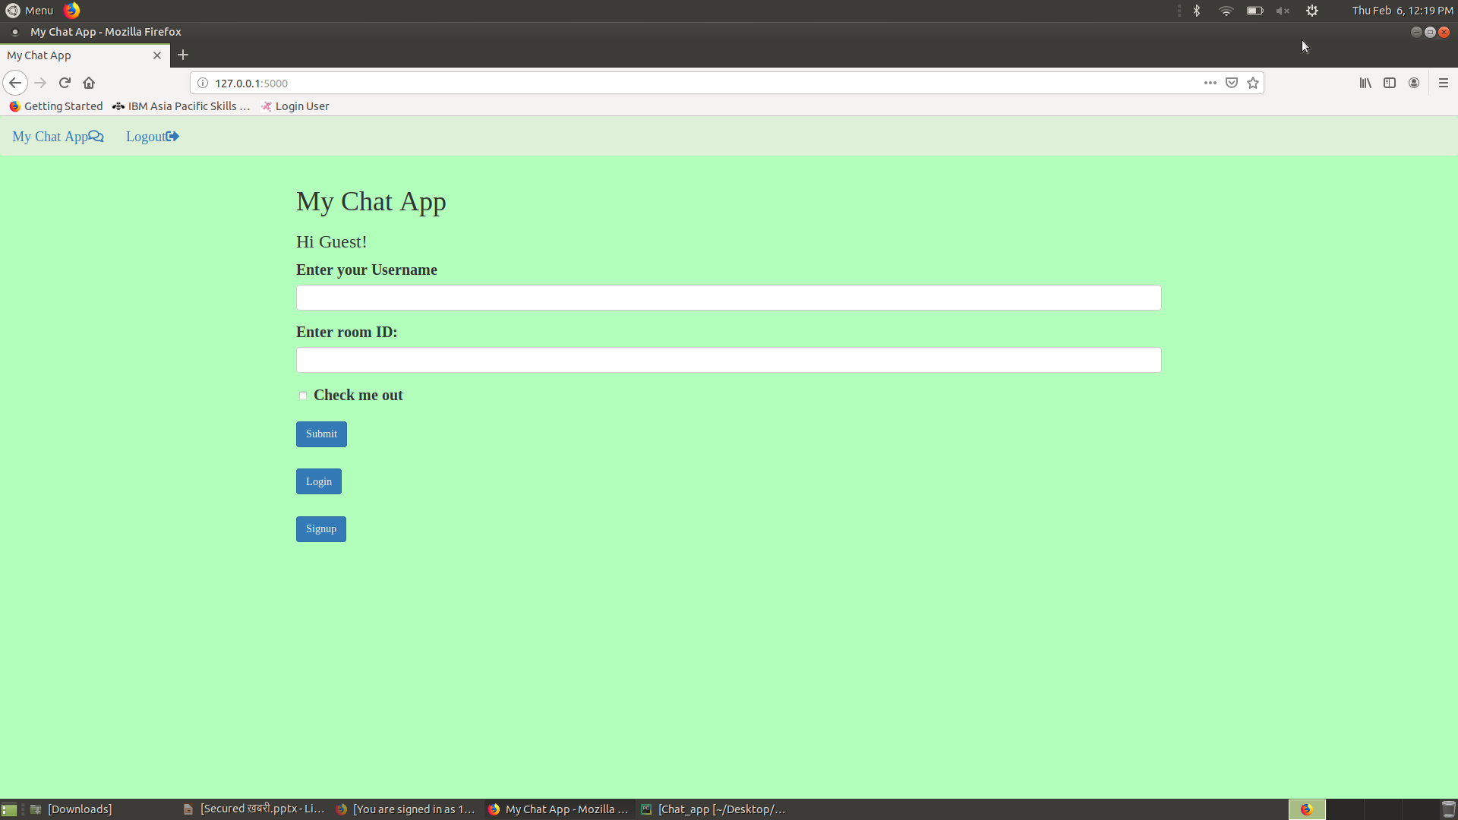
Index Page

Slide 12
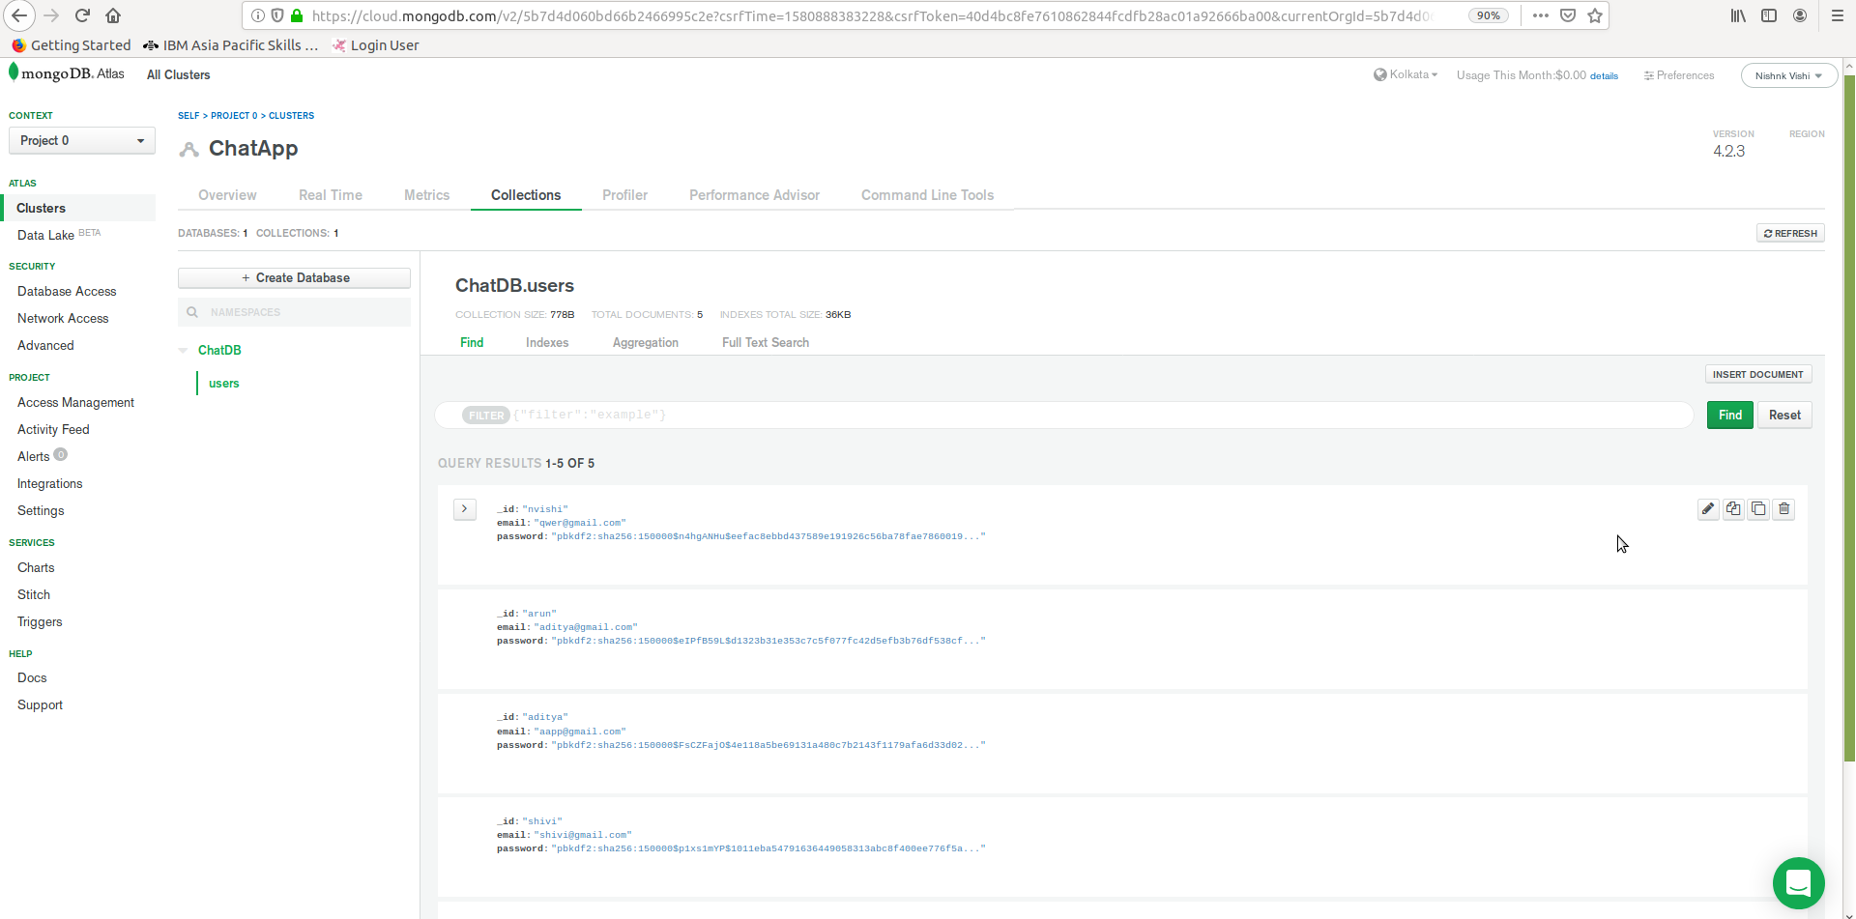
DataBase (mongoDB)

Slide 13
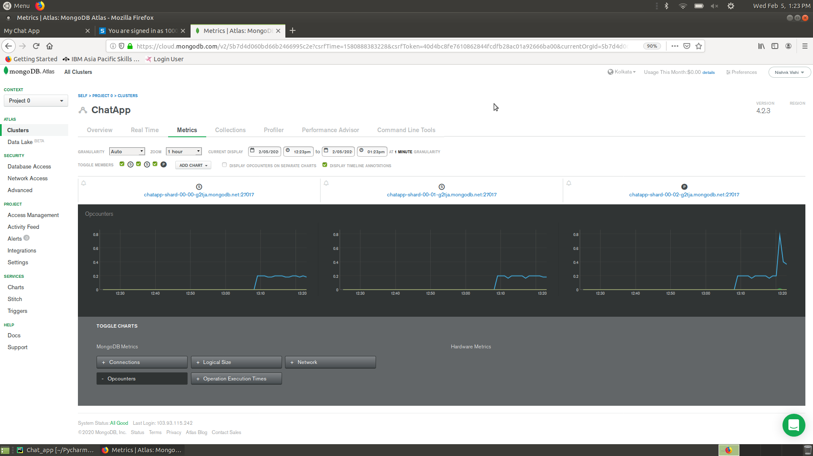
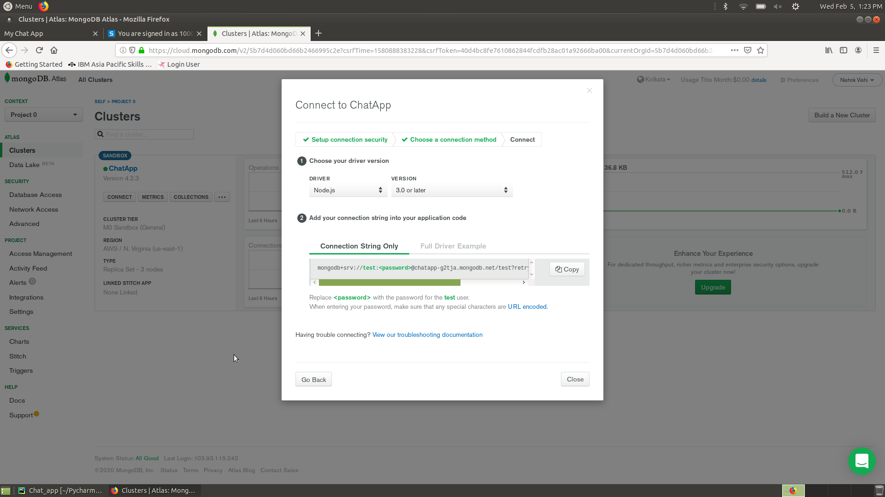
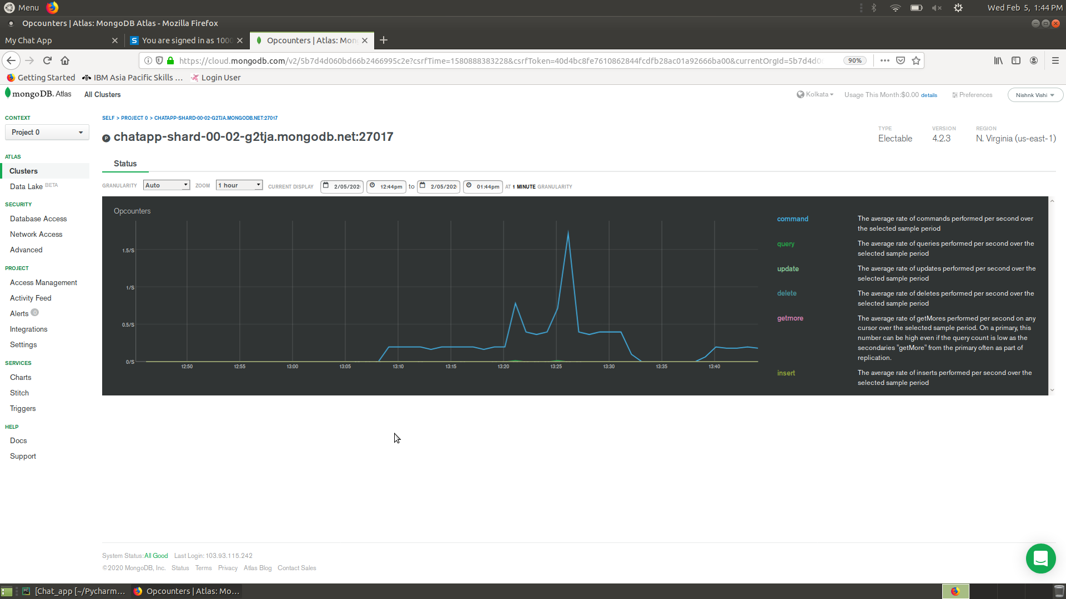
Managing our database

Slide 14
Upgradation in the Project
Added some upgradation in the functionality of the chat application
More interactive UI
Chat room functionality such as
Saving messages in the database and creating the chat history
Creating and editing the permanent rooms
Getting info about the room members
Addition and removal of users in the chat room
Broadcasting images in the rooms

Slide 15
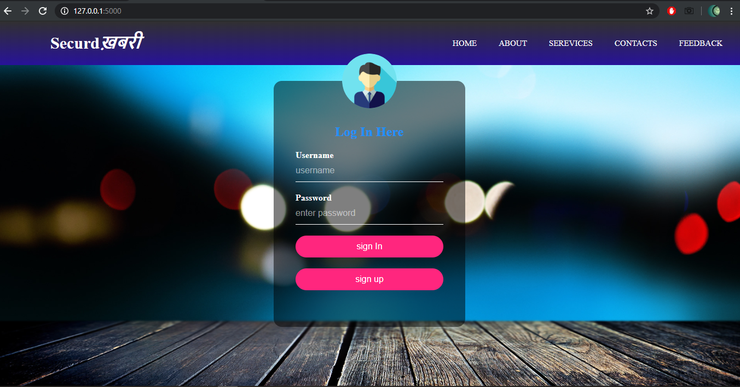
Login Page

Slide 16
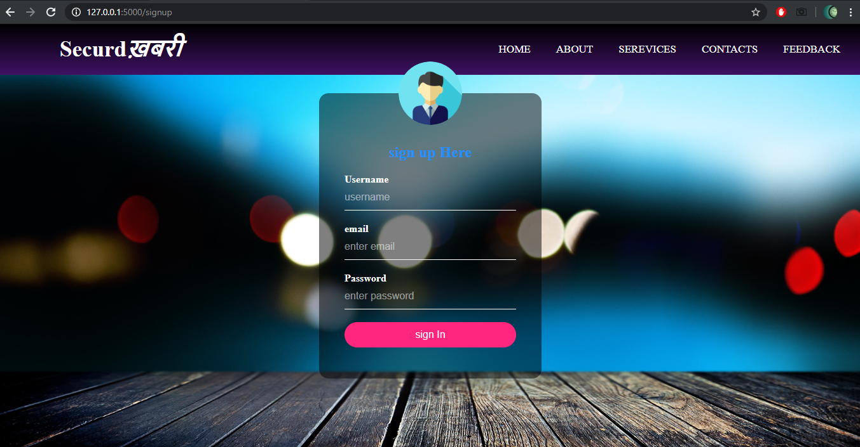
Sign Up Page

Slide 17
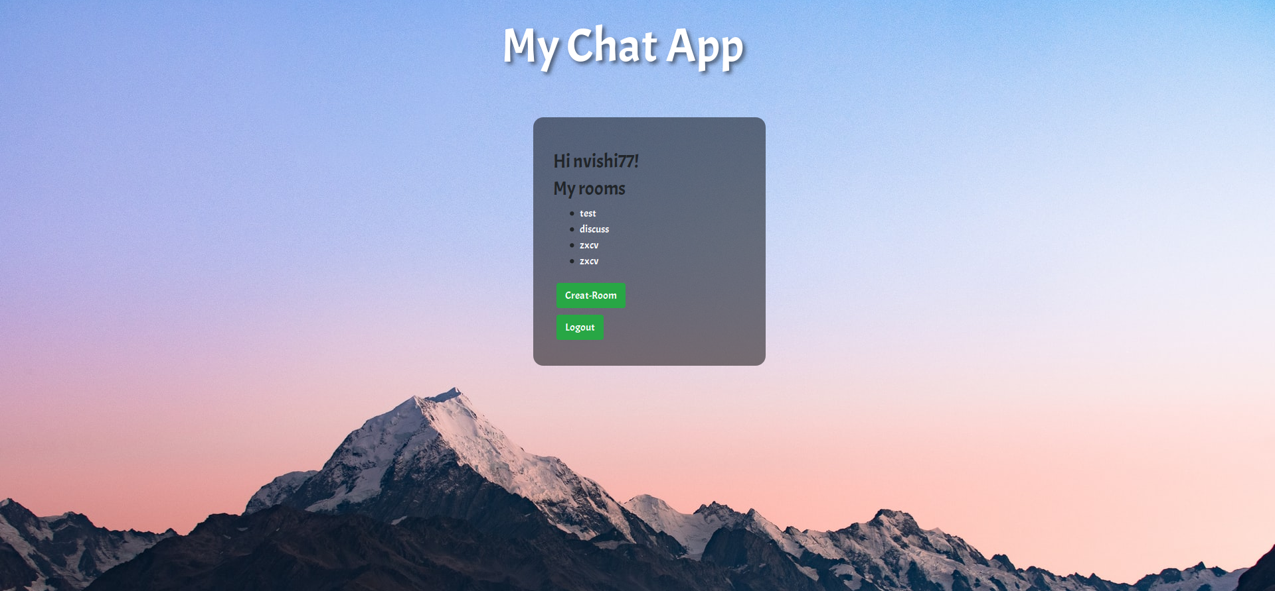
User’s Available Rooms

Slide 18
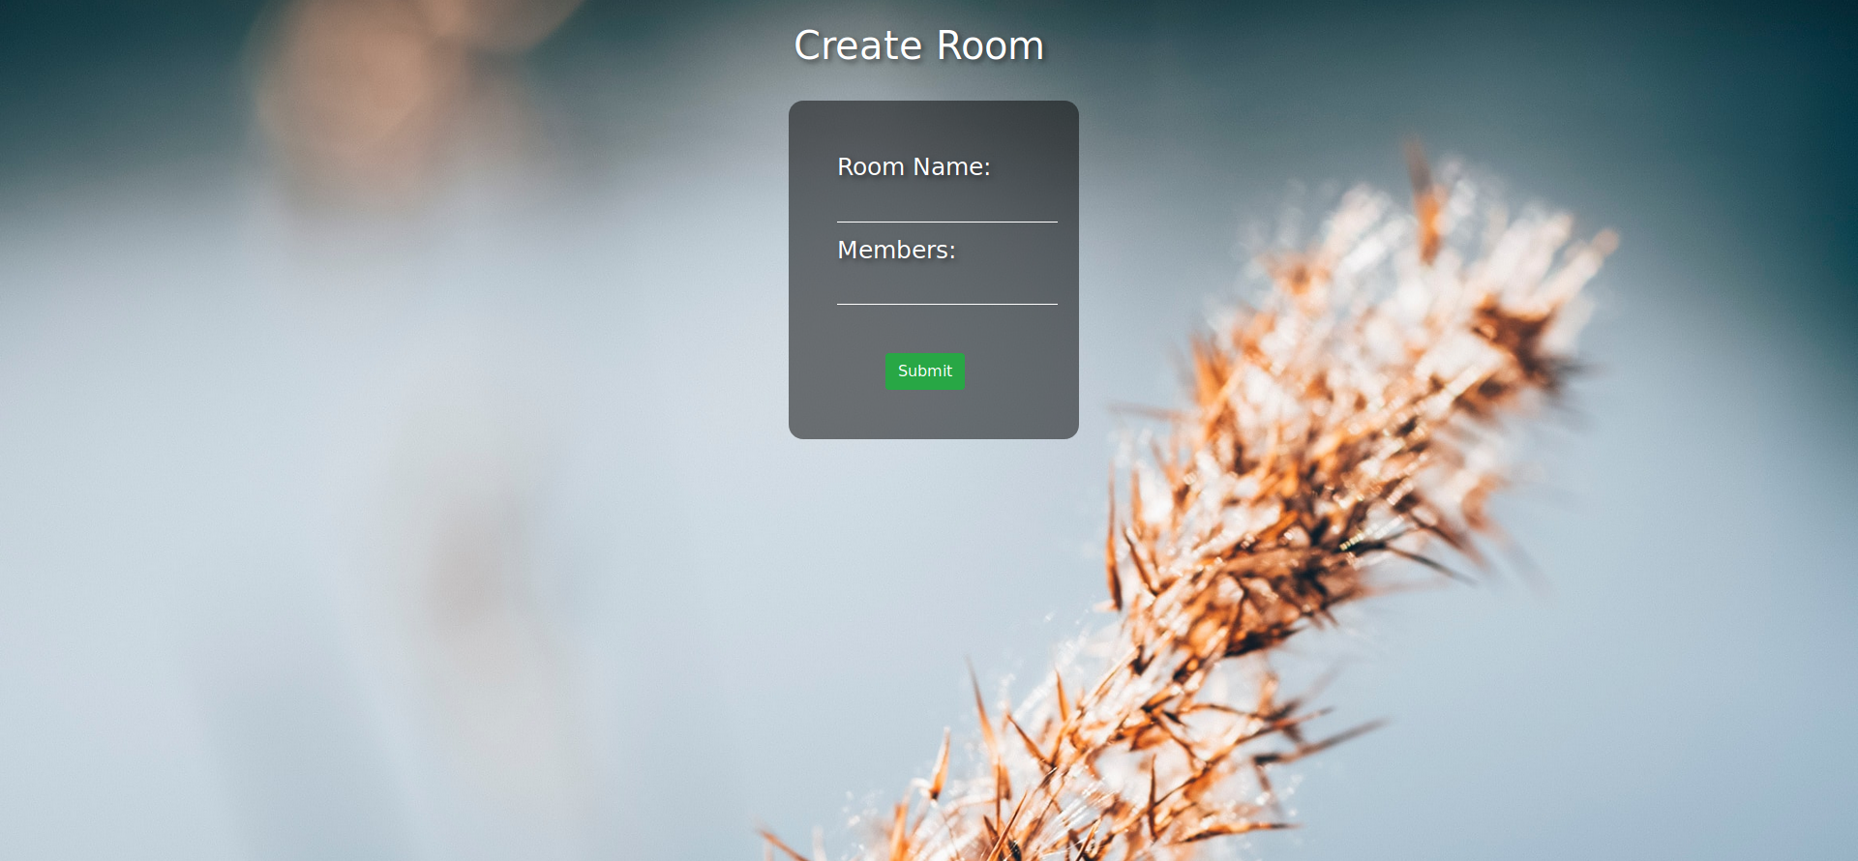
Creating Rooms

Slide 19
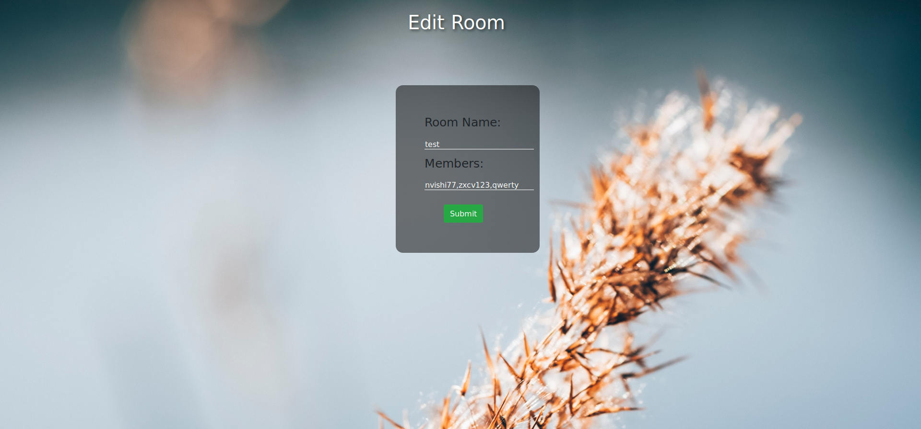
Editing Rooms

Slide 20
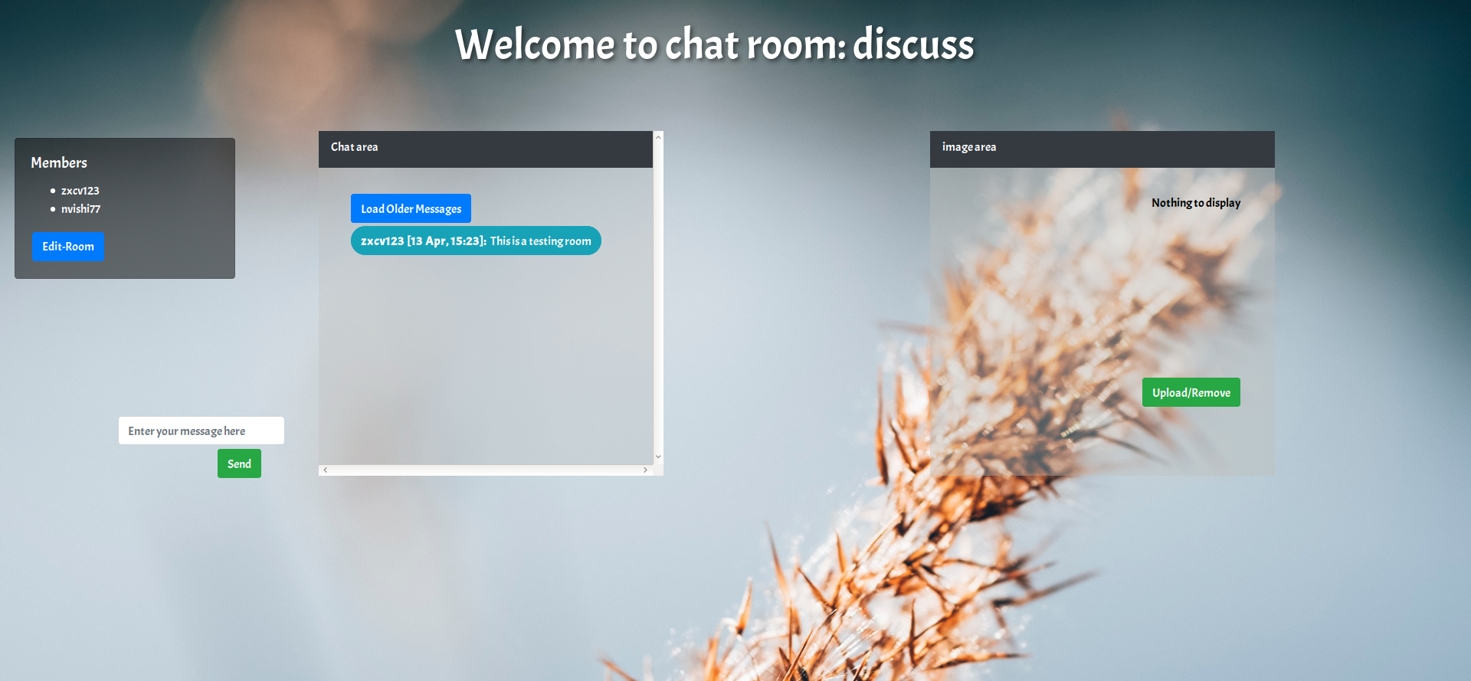
Chat Room

Slide 21
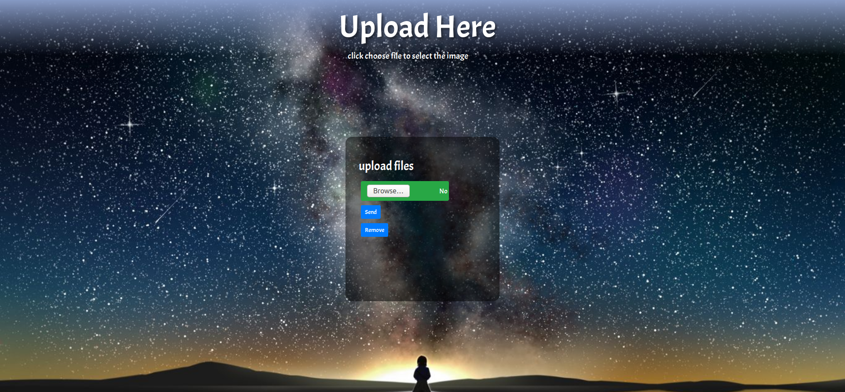
Page for Uploading Image

Slide 22
Briefing of Work Flow

Slide 23
Steganography Algorithm

Slide 24
Flask chat Algorithm

Slide 25
Finalizing the Secured ख़बरी
Merge steganography with the chat.
Improve the algorithms to hide the message
Implement chat app on cloud.
Give options to the user to choose the algorithm.
Improve UI

Slide 26
Thank You!
Team Members:
Aditya Arun 170110055
Aditya Parashar 170110054
Nishnk Vishi 170110047
Shivansh Gupta 170110010

